Slide 1

Opening the Black Box:
How things work matters
BRANDON ROHRER
Data Scientist, Facebook

Slide 2
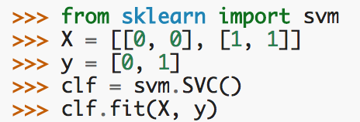

Black box:
Support vector machines
PHOTO HERE

Slide 3
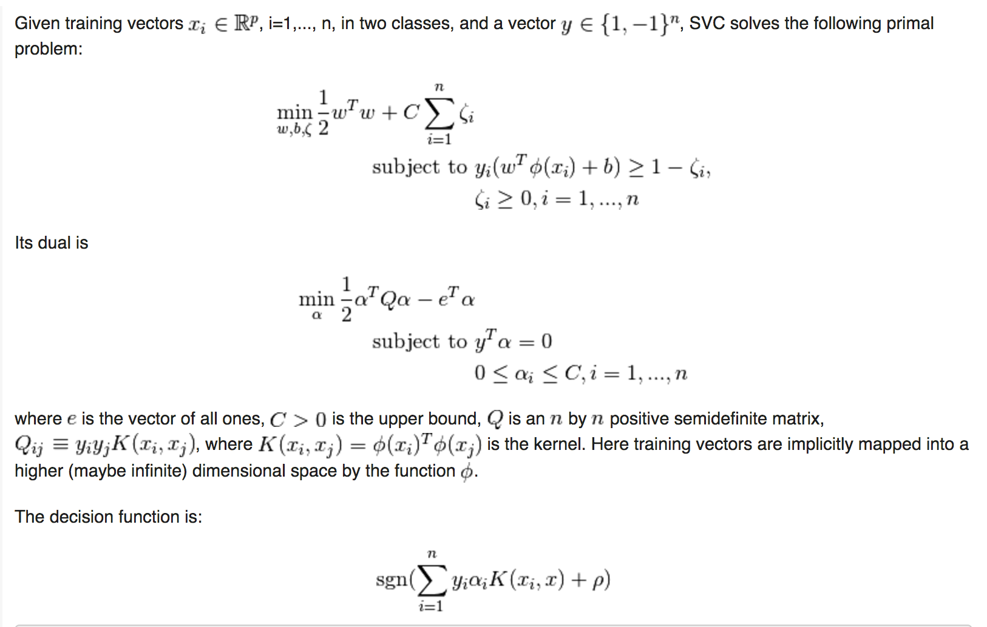
Step 1: Read scikit-learn docs

Slide 4
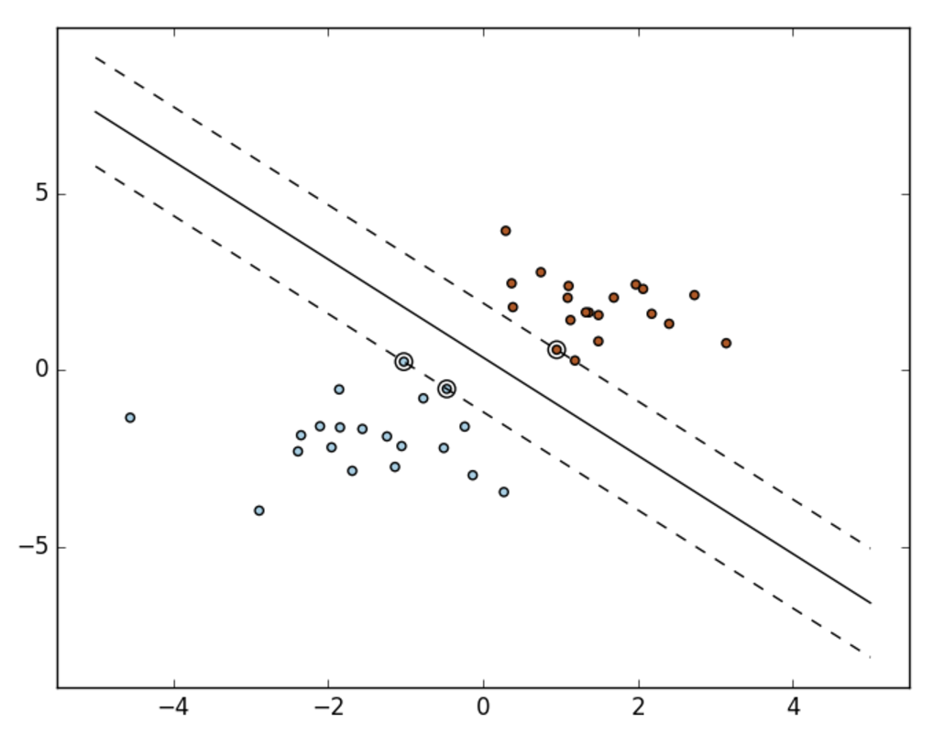
Step 1: Read scikit-learn docs

Slide 5
Step 2: Read tutorial

Slide 6
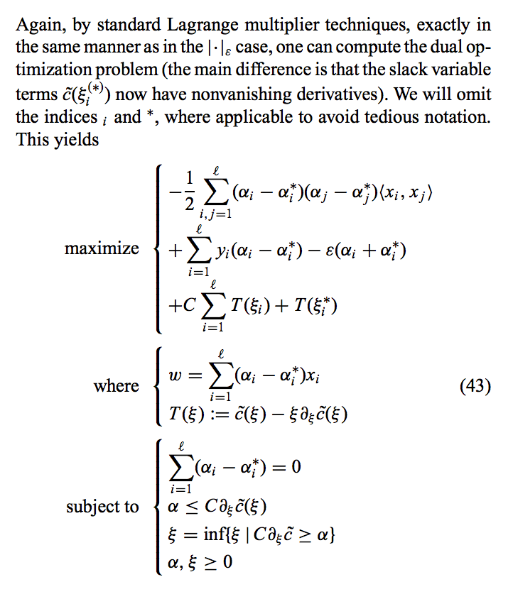
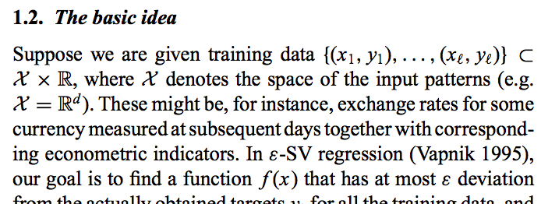
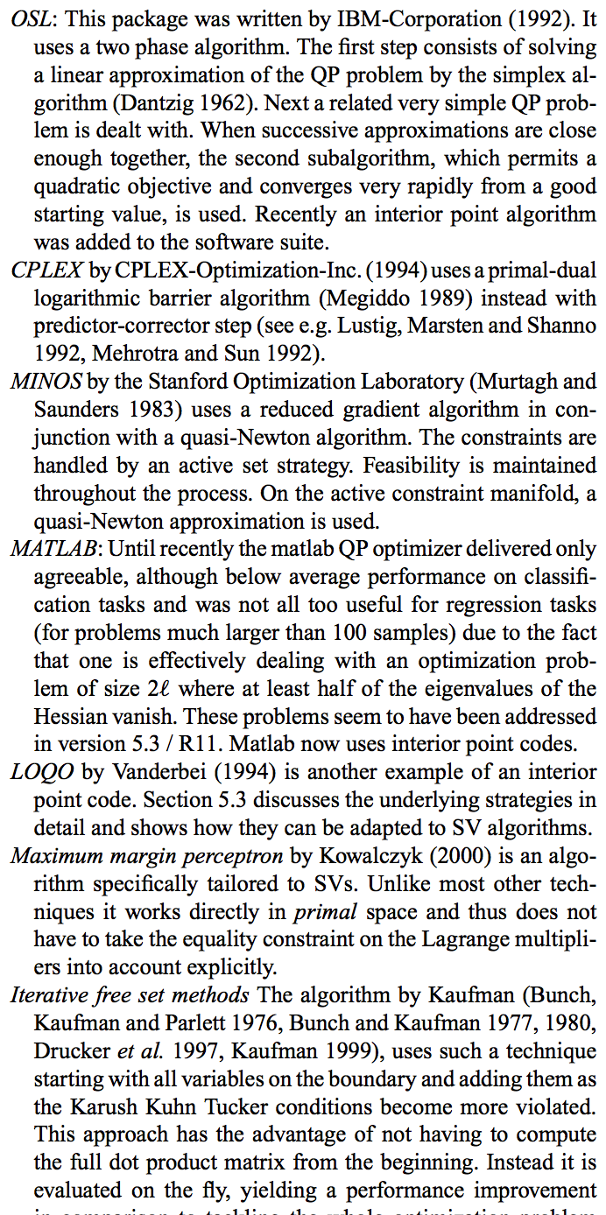
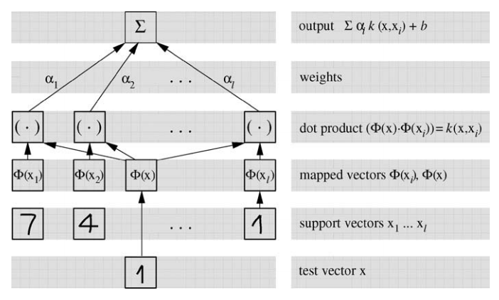
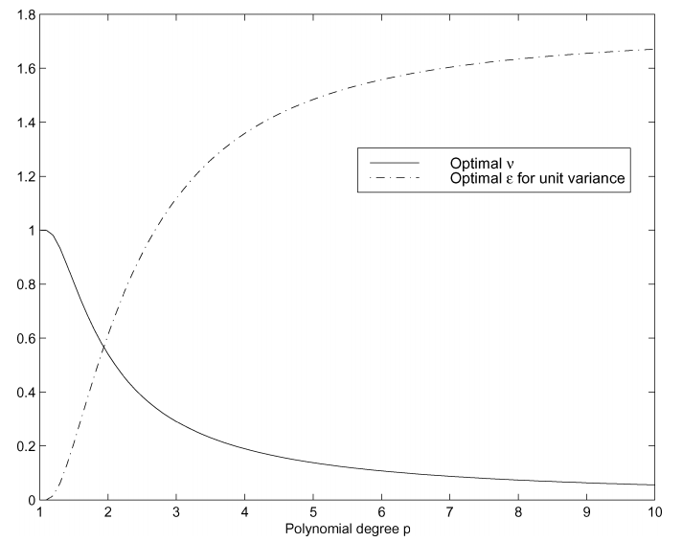
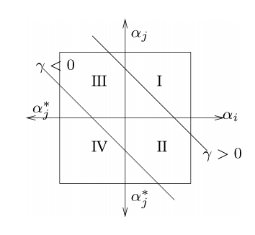
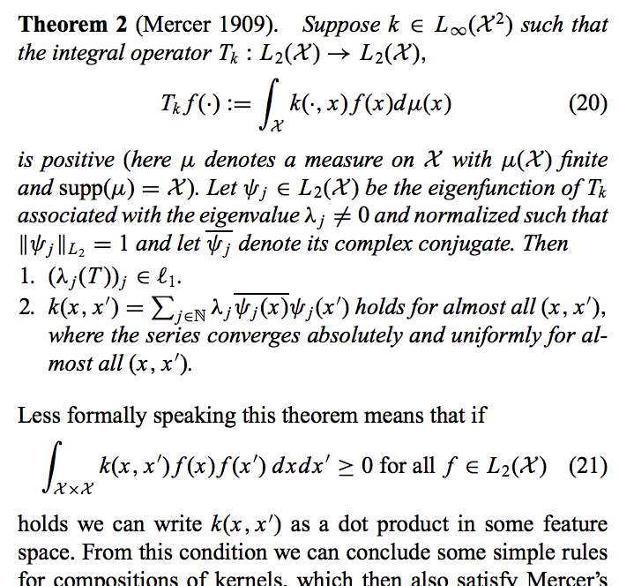
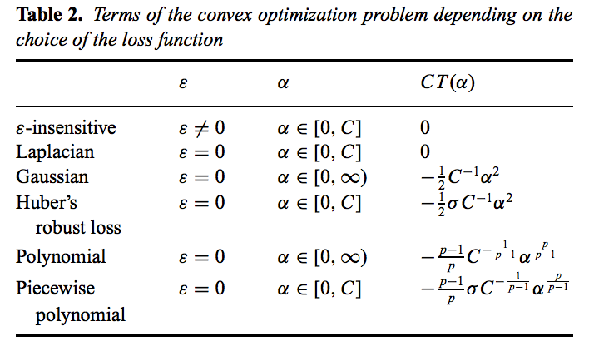
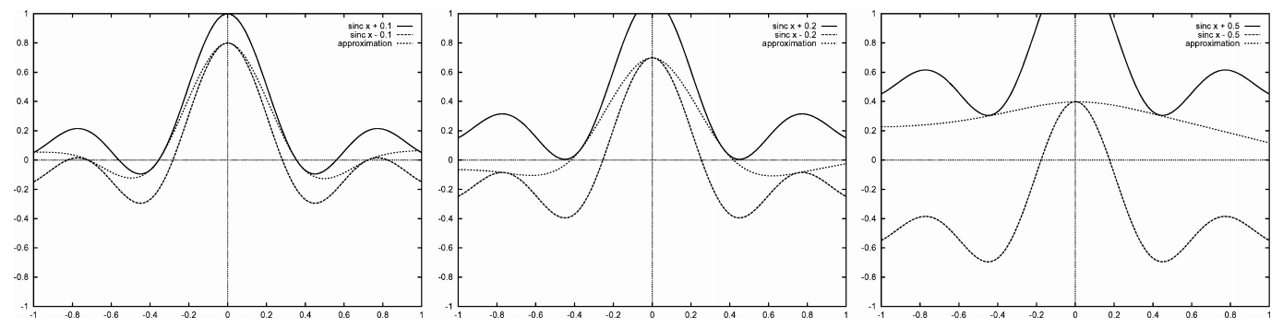
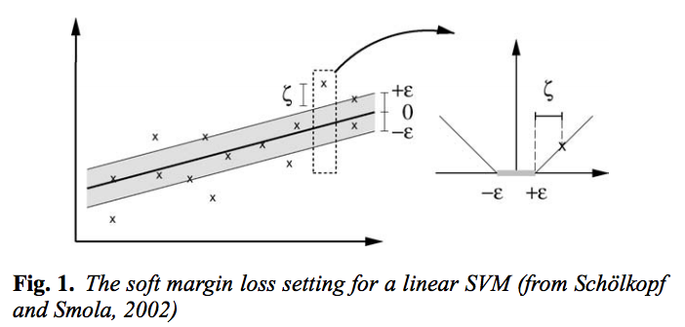
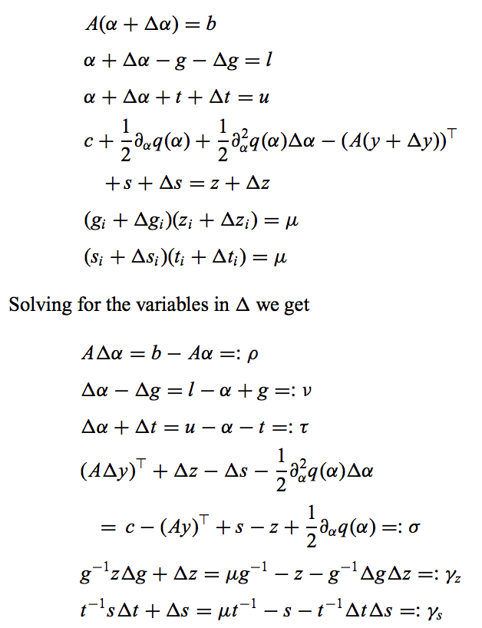
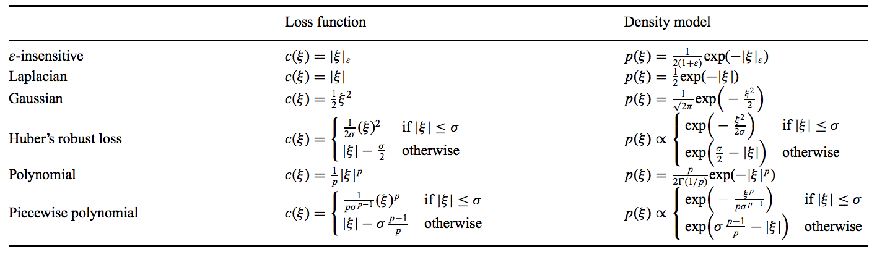
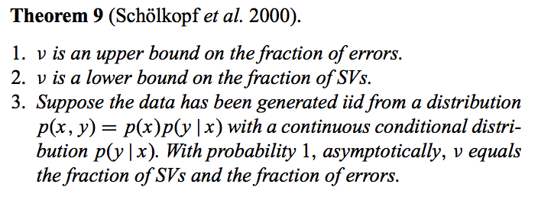

Slide 7
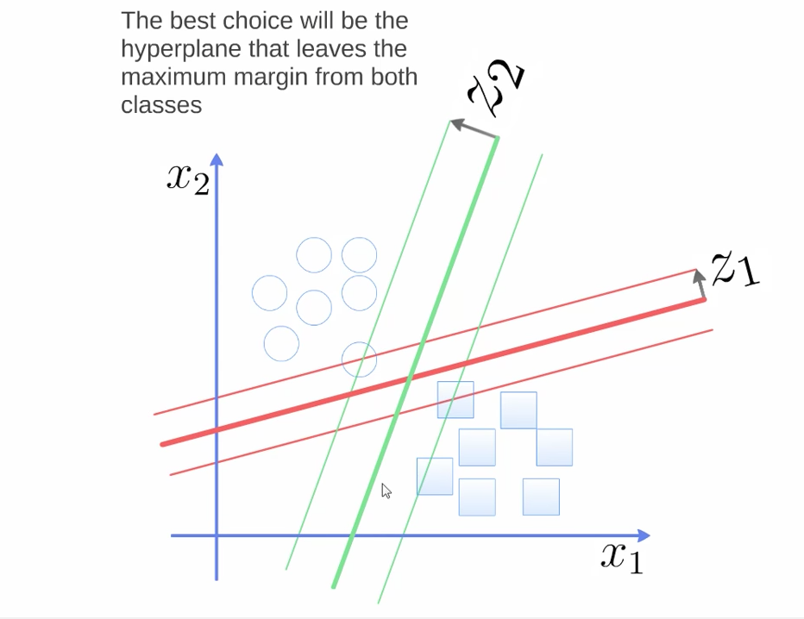
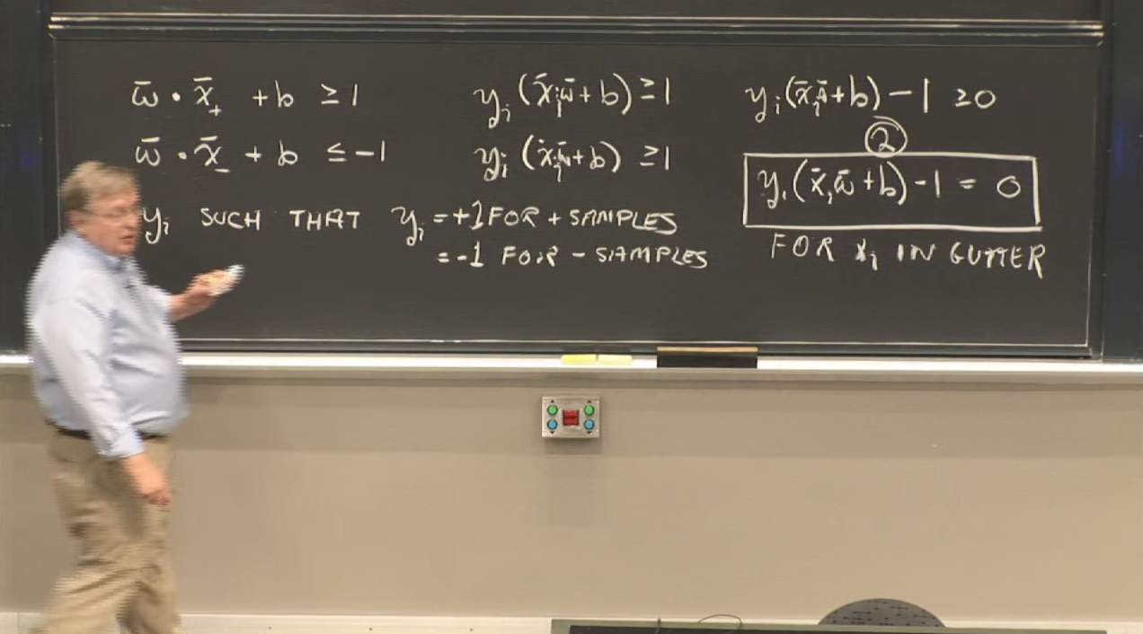
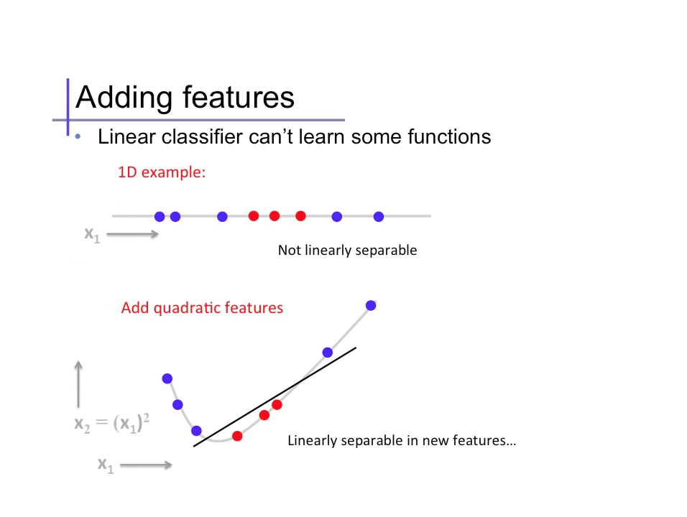
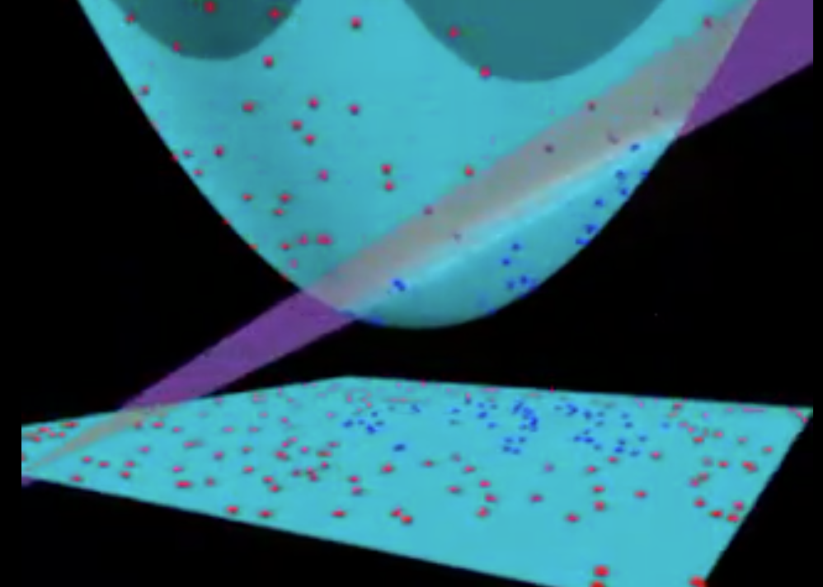
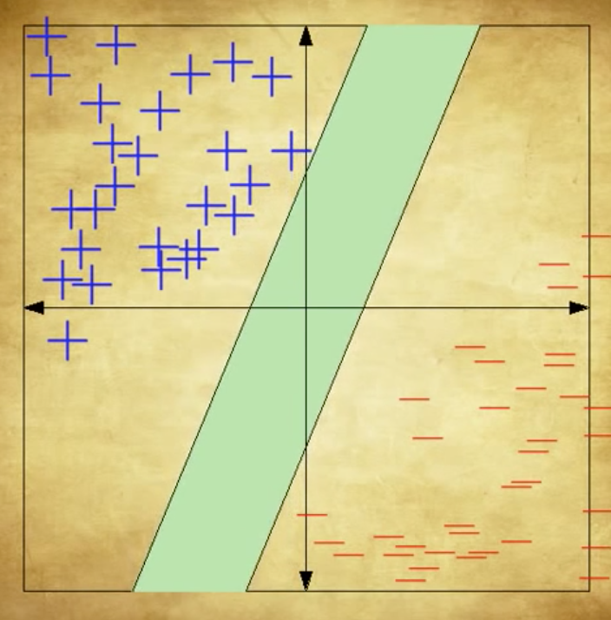
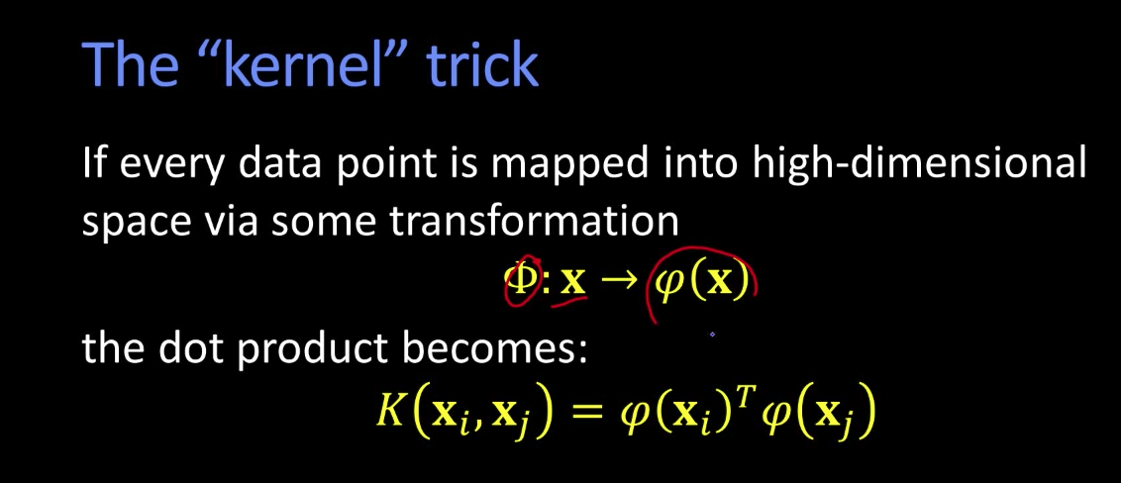
Step 3: Watch YouTube videos

Slide 8
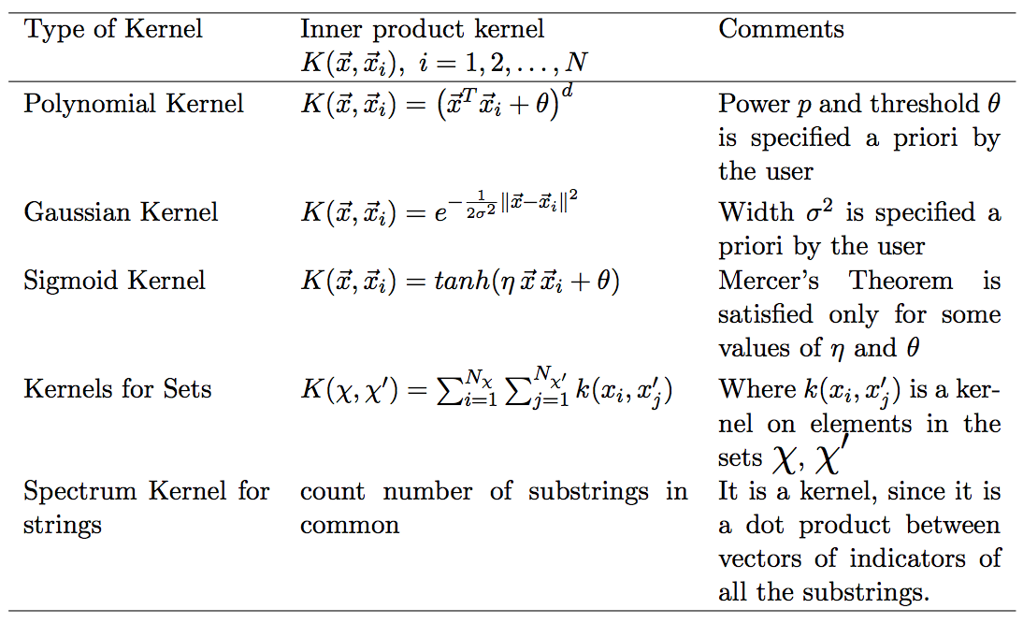
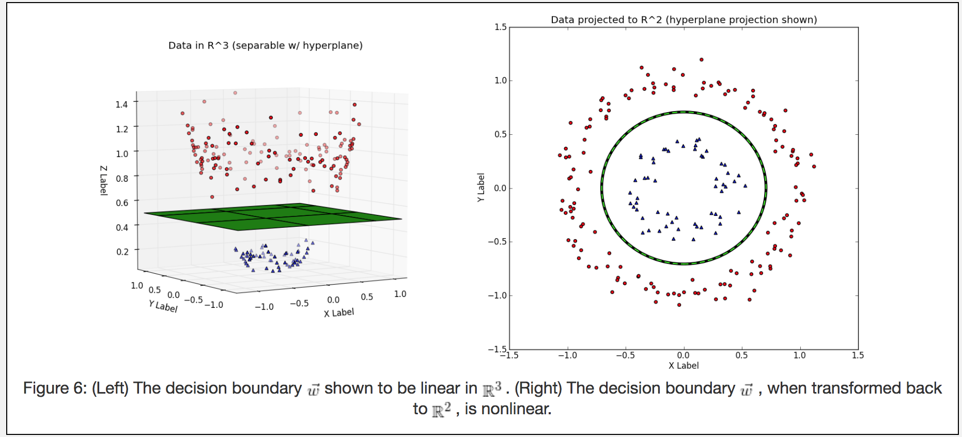
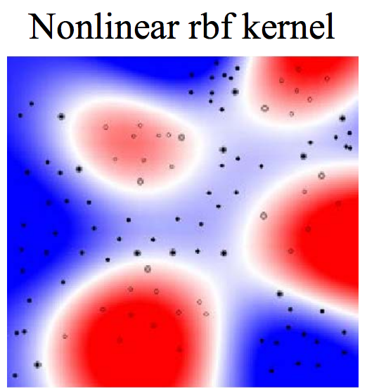
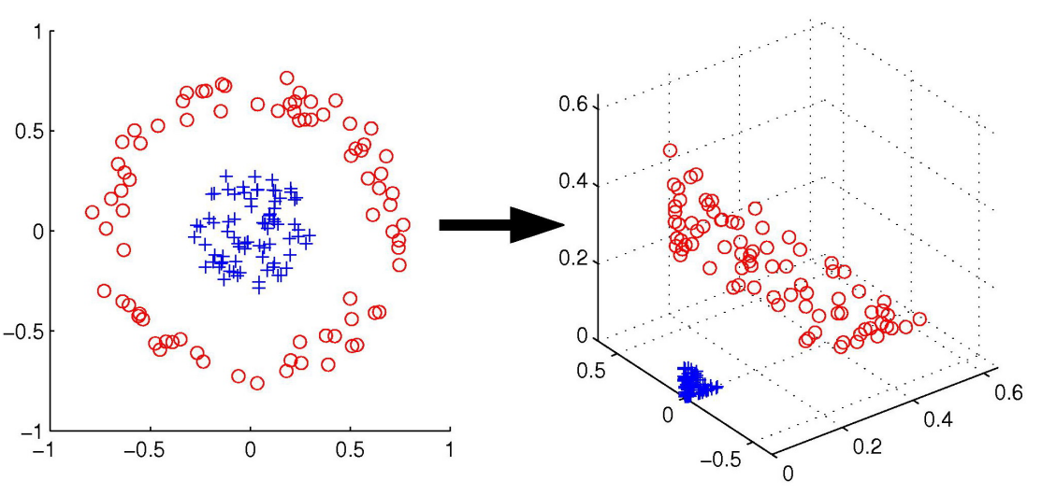
Step 4: Read more posts
SUBTITLE
Integer posuere erat a ante lorem venenatis dapibus posuere velit aliquet sit dolora.
PHOTO HERE

Slide 9
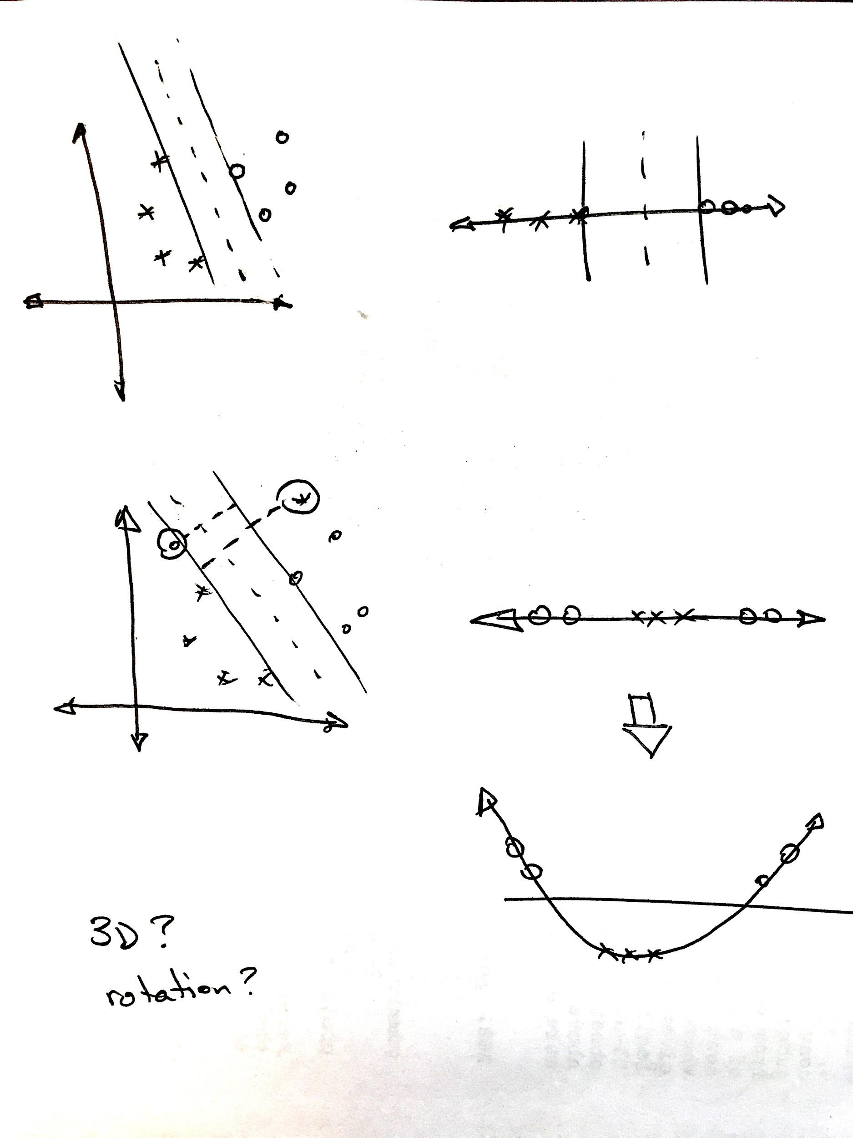
Step 5: Draw pictures.

Slide 10
Step 6: Choose a toy example.
A fruit is either
small or large and
yellow or purple.
A small yellow fruit is an unripe plum. It is not good to eat.
A small purple fruit is a ripe plum. It is good to eat.
A large yellow fruit is a ripe peach. It is good to eat.
A large purple fruit is a rotten peach. It is not good to eat.

Slide 11
Step 6: Choose a toy example.
large
large
ripe peach
rotten peach
yellow
purple
unripe plum
ripe plum
small
small

Slide 12
Step 7: Explain it to a 12 year old.
peaches
yellow
purple

Slide 13
peaches
yellow
purple

Slide 14
peaches
yellow
purple

Slide 15
peaches
yellow
purple

Slide 16
peaches
yellow
purple

Slide 17
peaches
yellow
purple

Slide 18
large
yellow
purple
small

Slide 19
large
large
yellow
purple
yellow
purple
small
small

Slide 20
large
large
yellow
purple
yellow
purple
small
small

Slide 21
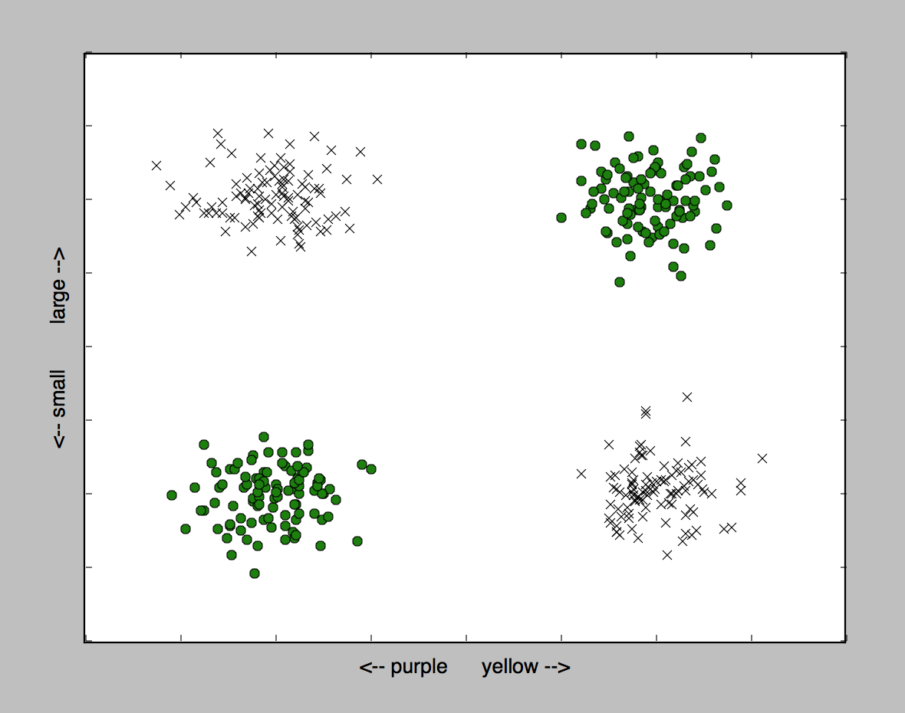

Slide 22
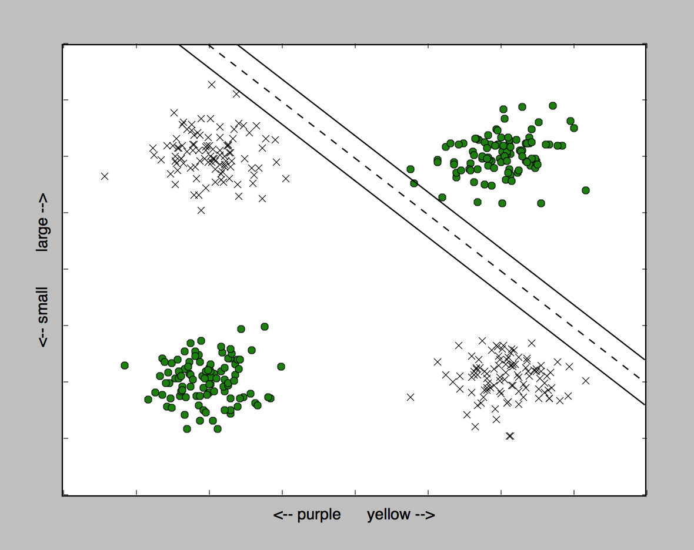

Slide 23
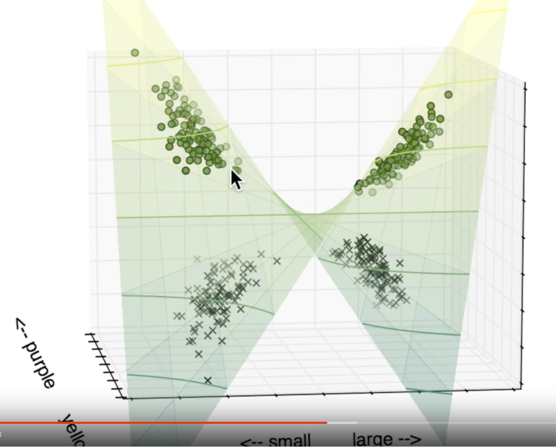

Slide 24
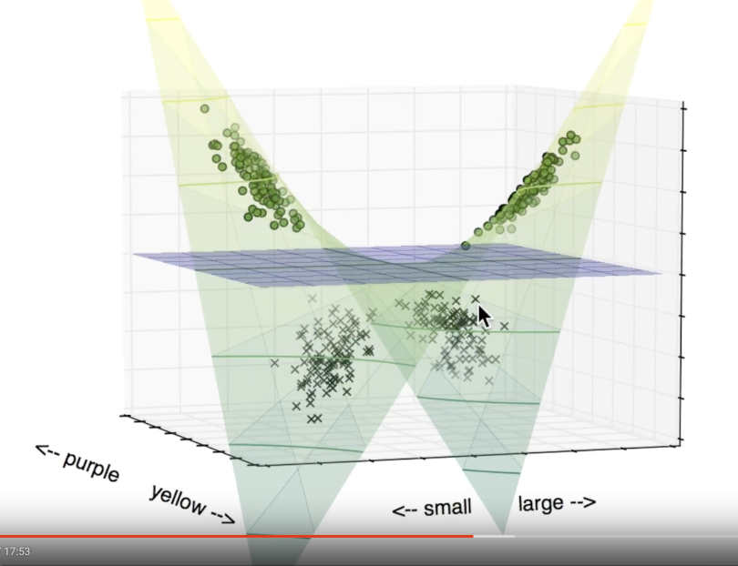

Slide 25
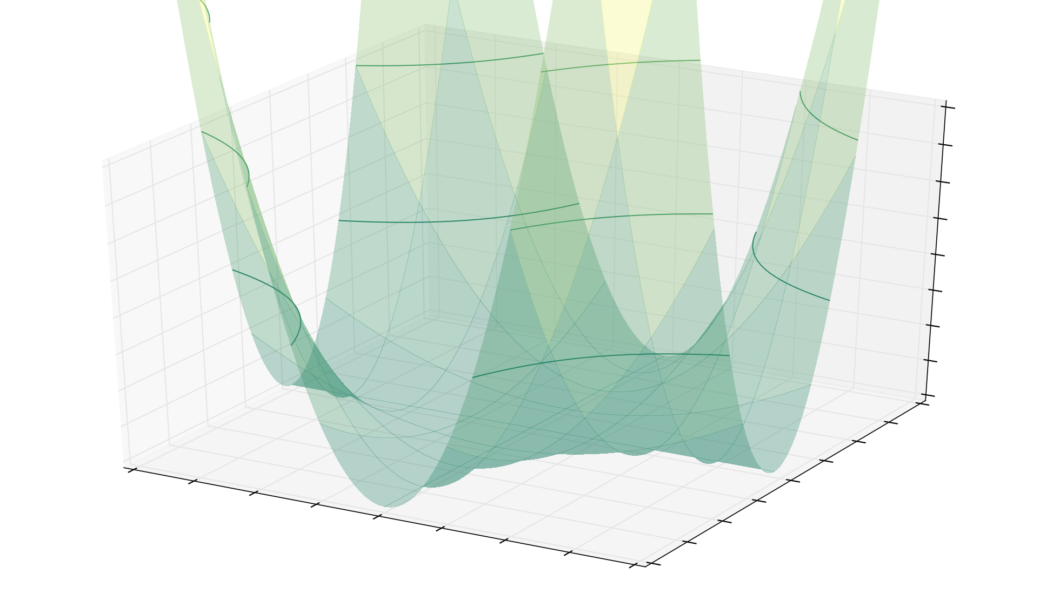

Slide 26
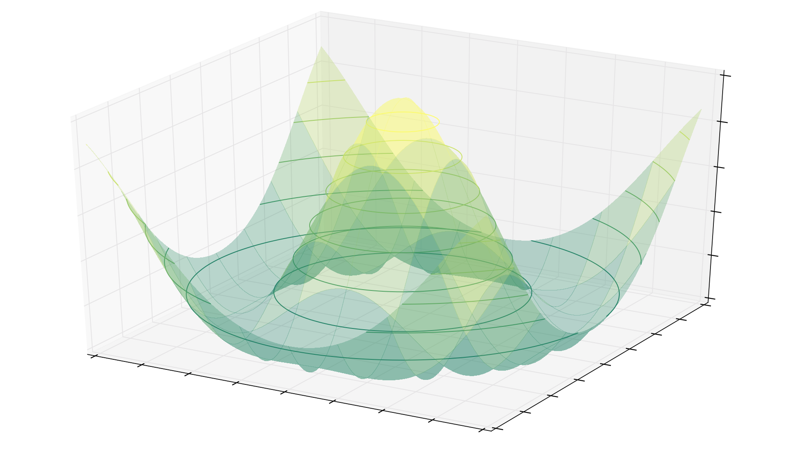

Slide 27
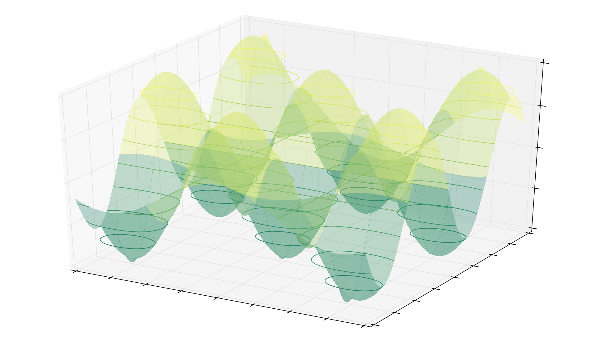

Slide 28
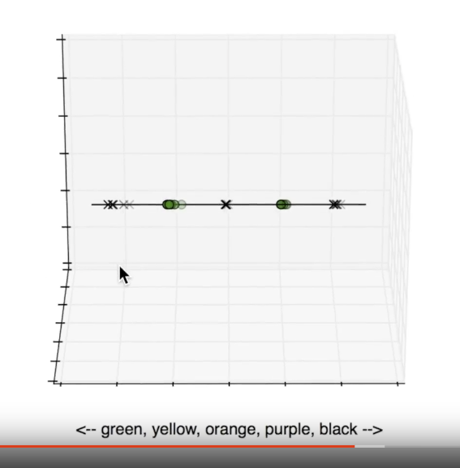

Slide 29
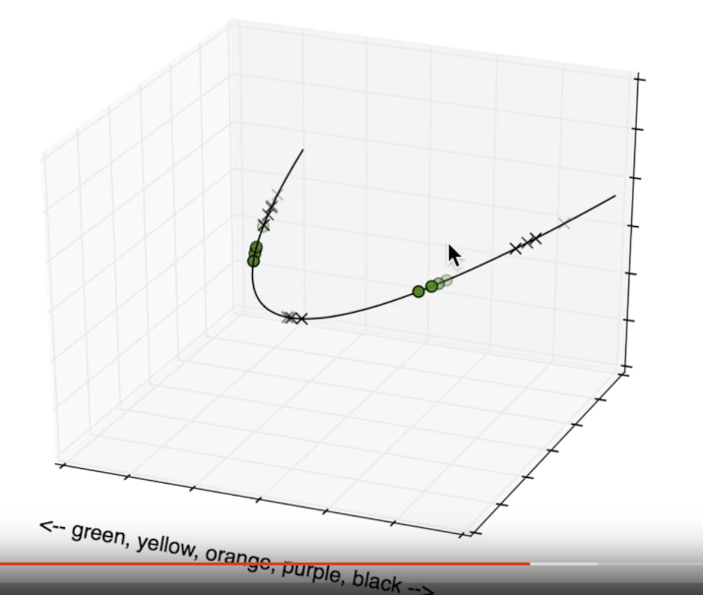

Slide 30
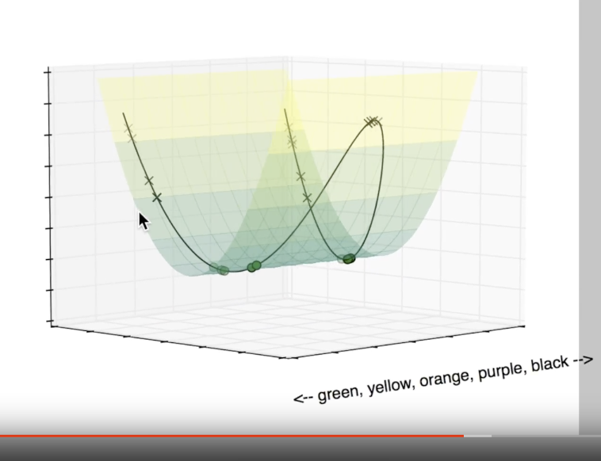

Slide 31
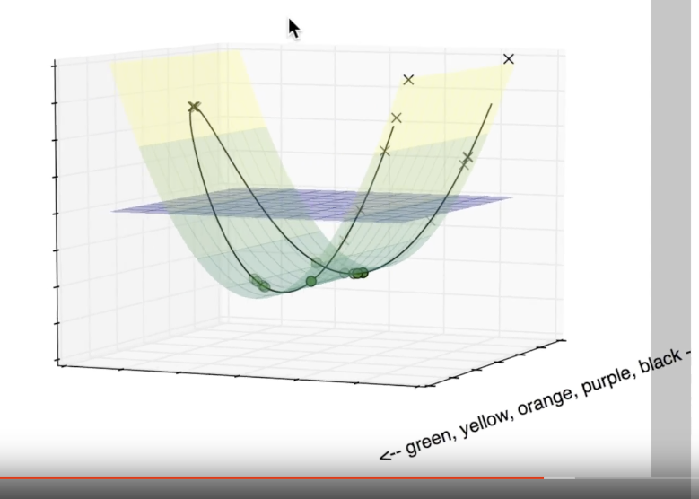

Slide 32
Step 8: How can it break?
Data with lots of error.
Discriminator location depends entirely on the few nearest data points.
Choosing the wrong kernel.
Kernel selection is trial and error.
Large data sets.
Calculating the kernel is expensive.
Each of these requires a human in the loop to make judgment calls.

Slide 33

Open the box.

Slide 34
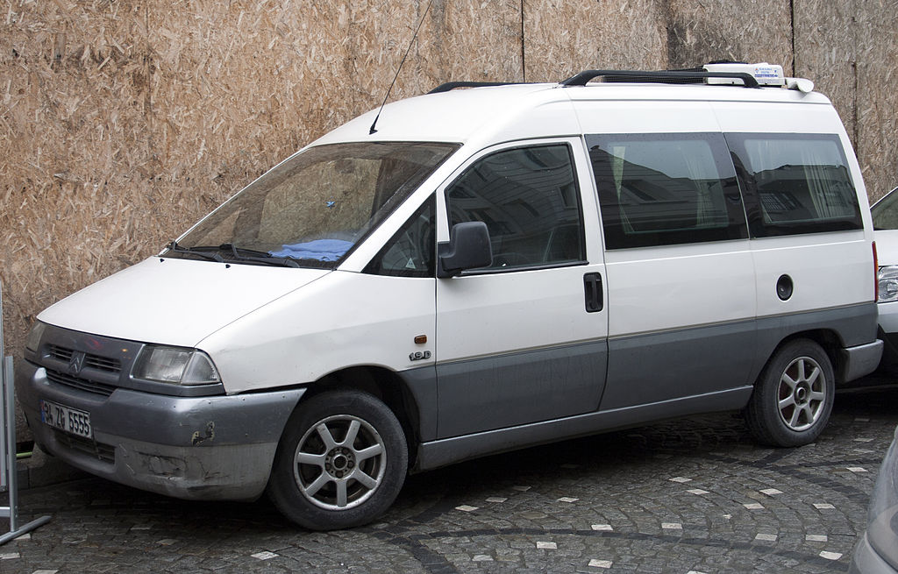
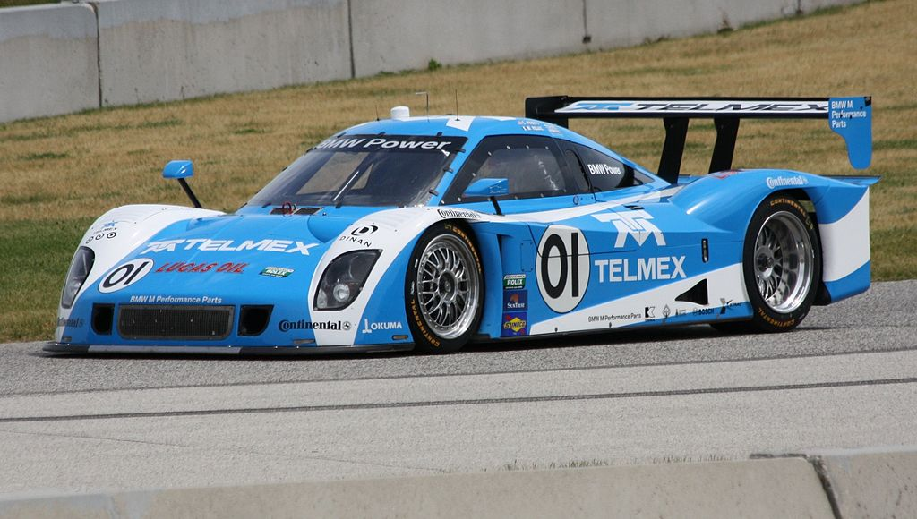
Open the box.

Slide 35
Resources
Code for examples
YouTube video
Minivan photo By Mr.choppers (Own work) [CC BY-SA 3.0 (http://creativecommons.org/licenses/by-sa/3.0) or GFDL (http://www.gnu.org/copyleft/fdl.html)], via Wikimedia Commons
Racecar photo By I, the copyright holder of this work, hereby publish it under the following license: (Own work) [CC BY-SA 3.0 (http://creativecommons.org/licenses/by-sa/3.0)], via Wikimedia Commons
Box photo CC0

